Slide 1
A Short History of Little Berkhamsted Village Hall
Penny Stokes

Slide 2
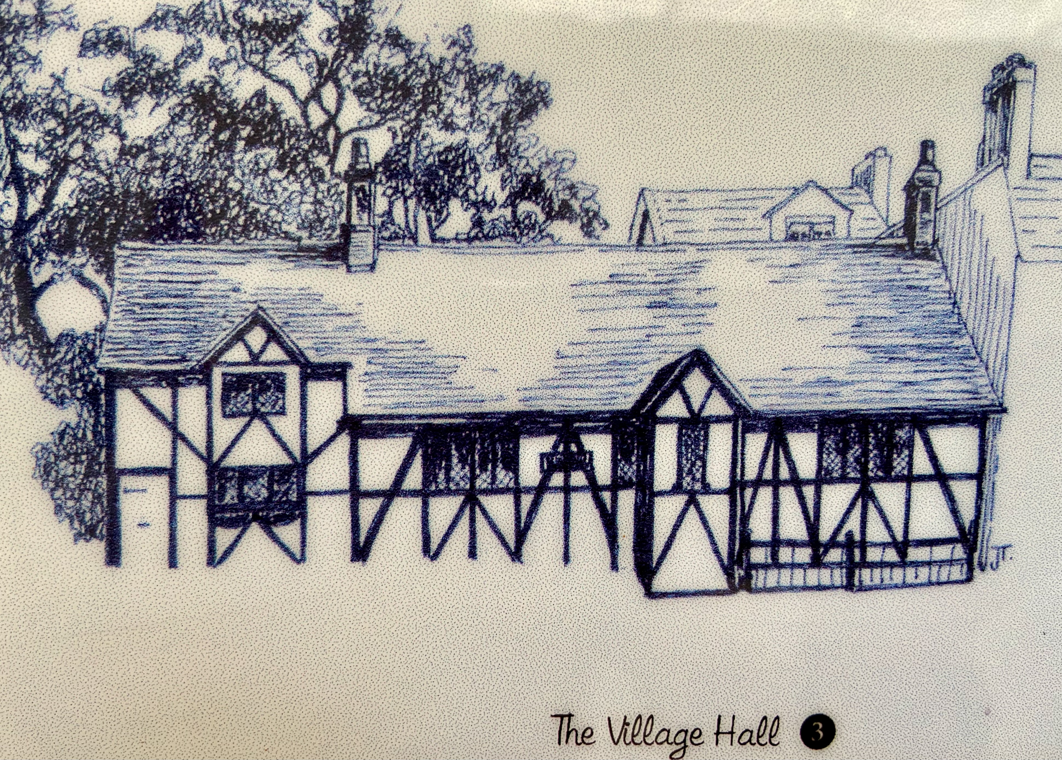
Early History
The Village Hall was built in 1888 by Percival Bosanquet, who lived in Old Manor. He bought the Old Manor in 1880 from a London building contractor, John J Johnson. Owing to a quarrel between Mr Bosenquet and Mr Johnson, the latter built The Limes as close as possible to the Hall to prevent its enlargement!

Slide 3
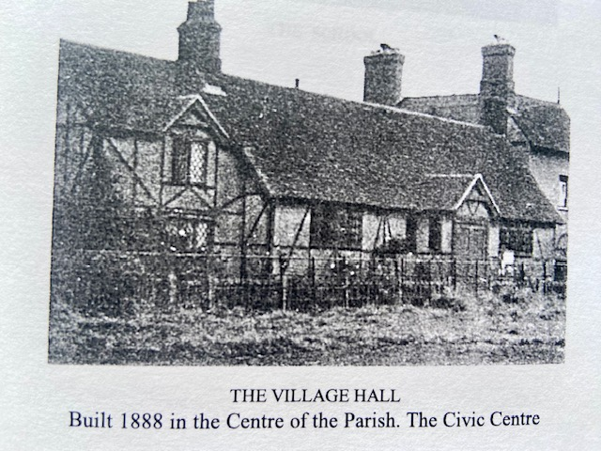

Slide 4
Sir Brodie Henderson
As well as being the ‘Civic Centre’ the Hall was used as a Working Men’s Club before World War 1. Sir Brodie Henderson of Epping House, now called Henderson Place, covered the costs of maintenance.
Sir Brodie Henderson also owned the field in the village. His predecessor at Epping House, Sir William Horne had been granted this in an exchange of the Enclosure Award.

Slide 5
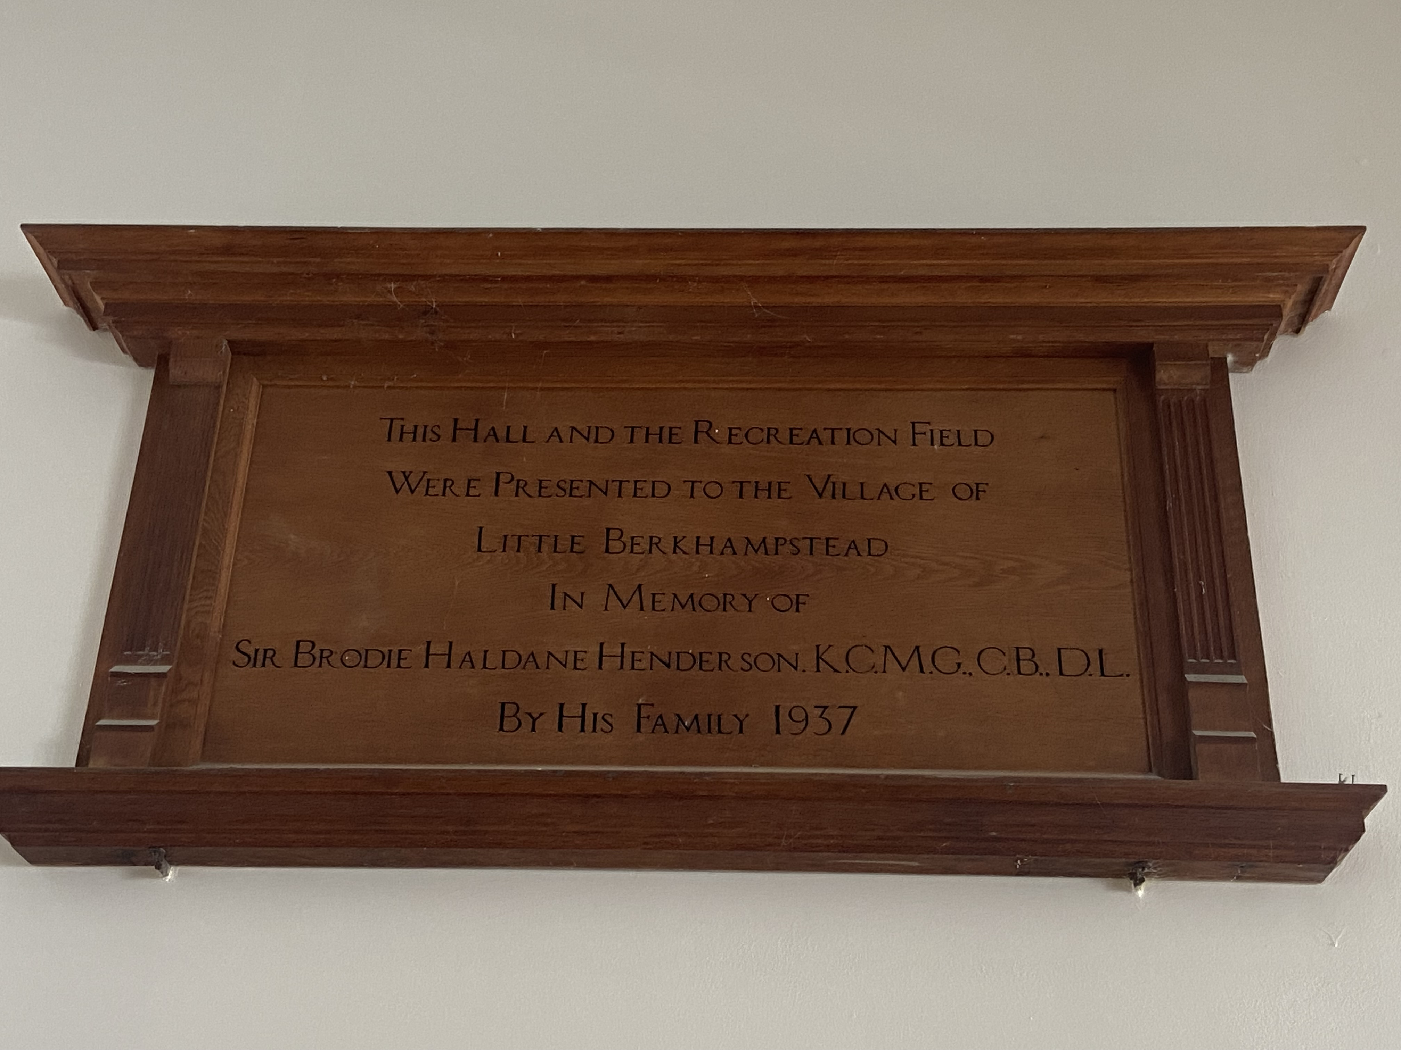
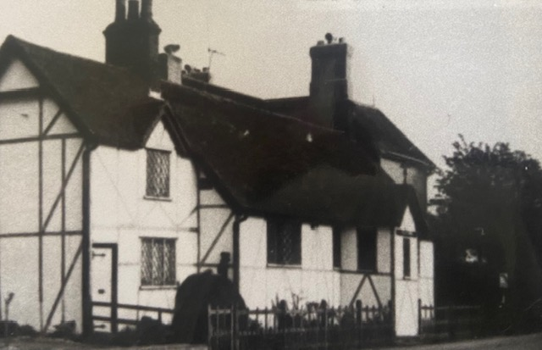

Slide 6
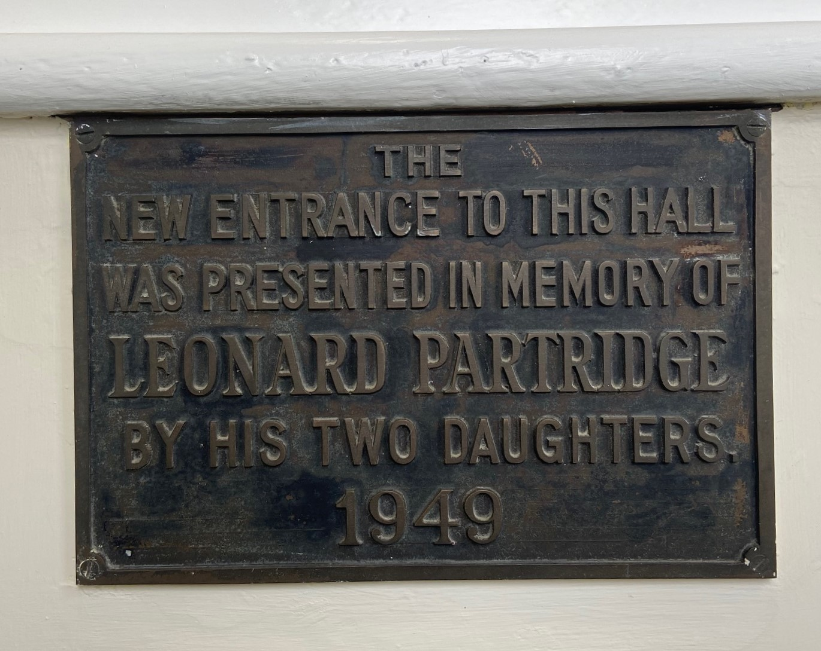
The Village Hall Entrance
Leonard was on the Parish Council, serving as Chairman for some time.
The Partridge family lived in Little Berkhamsted House from 1925 until Leonard’s death. It was then bought by the Chaplins

Slide 7
Where is the door?

Slide 8
Early Design
The hall originally had a stage at the left hand end where the kitchen and toilets are now.
It was heated by two large coke boilers.
The toilets were outside and could only be accessed via the stage.
There was no fire exit door on the back wall.

Slide 9
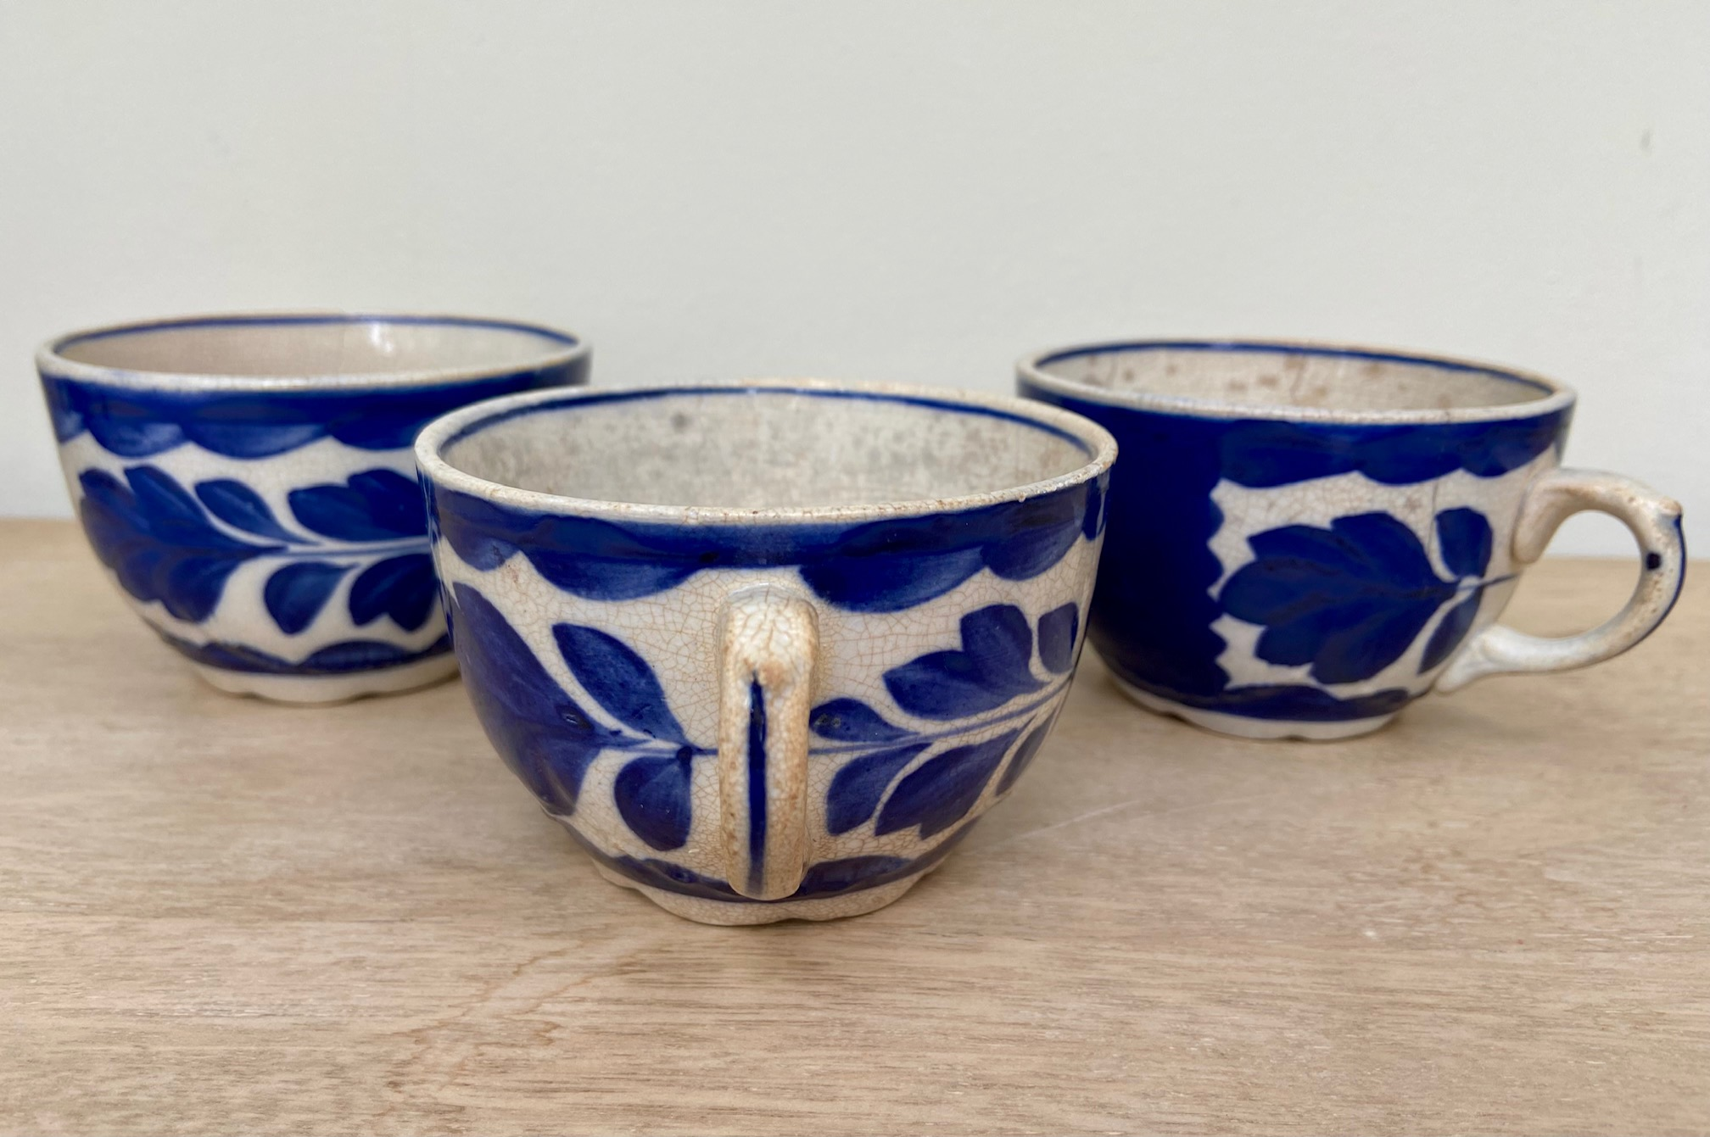
Three of the original cups bought for the hall
Courtesy of Rodney Pegg

Slide 10

World War II
During the war
After the war
D-Day 80th Anniversary
the hall was used by the Home Guard.
The cottage did not have a tenant at that time and was used by the Home Guard as their canteen.
the hall was a regular meeting place for local Ex –service personnel from the Army, Navy and Air Force.

Slide 11
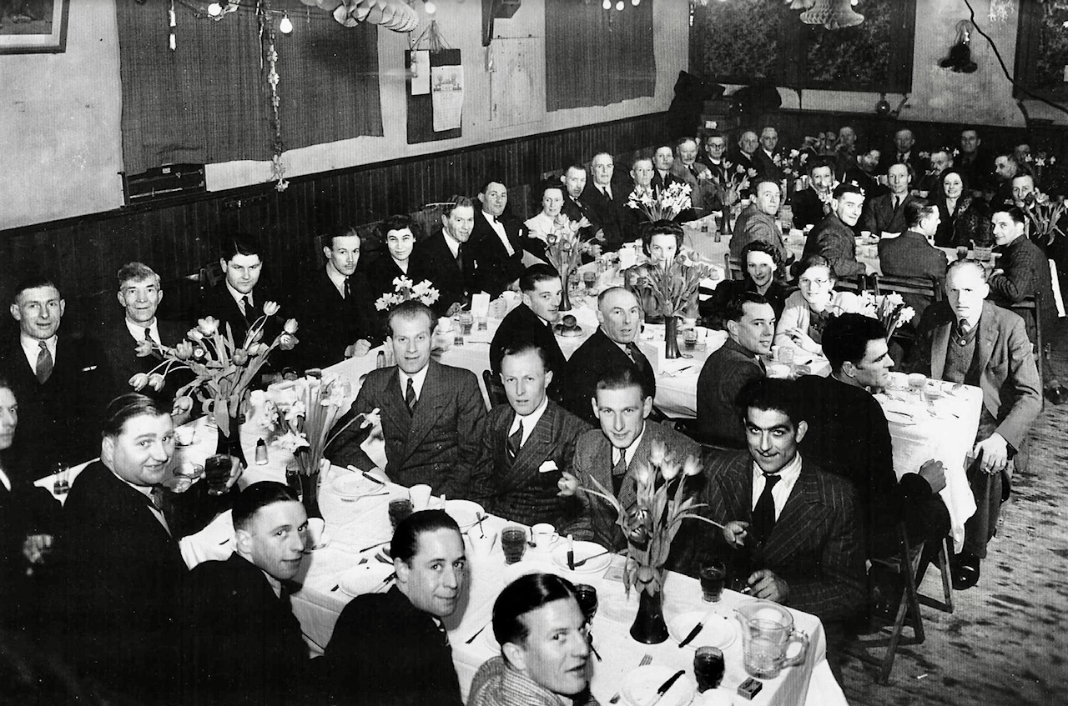
Early Memories of the Hall
Every year there was a Christmas Party in the hall. Rodney Pegg remembers a large Christmas tree on the stage lit with real candles, which looked very impressive.

Slide 12
1950s and 1960s
1957 – exterior decoration done and consideration given to inside toilets
1958 - mention in the minutes of concern of the infrequency of hall bookings!
1961 – A slot meter and 4 electric fan heaters installed
(The WI complained that they were ineffective and later they were lowered)
1963 – interior decorations done
1969 – damp is discovered under the stage. The kitchen facilities were ‘very bad’. The stage was rarely used. Plans drawn up for a kitchen and storeroom

Slide 13
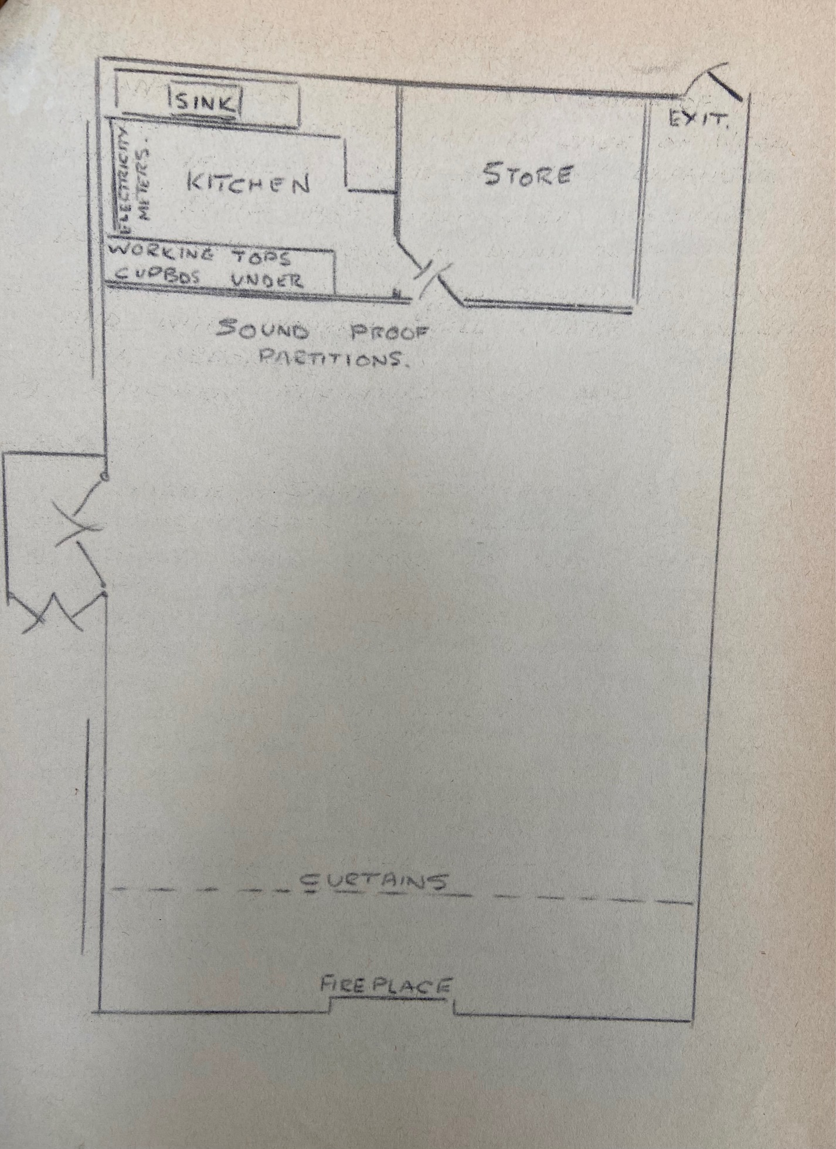
In 1971 the stage was removed, and a kitchen and storeroom were built at the north end of the hall by Mr A T Woods of Gladstone Road, Ware. The final cost of the work was £795.30.

Slide 14
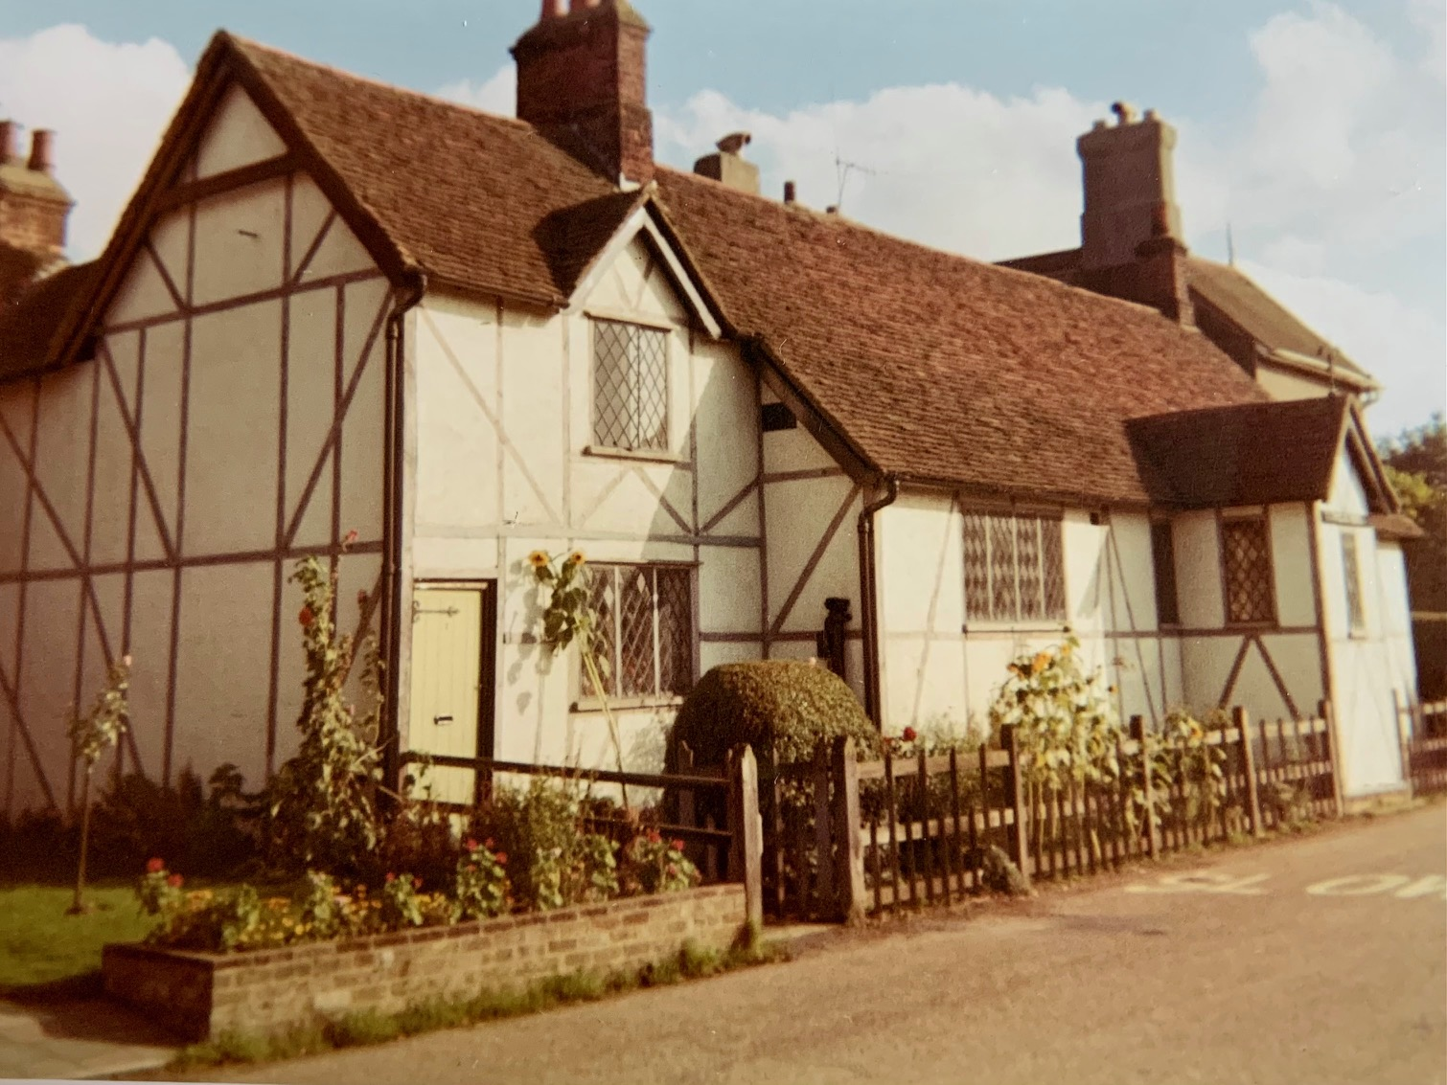
At this time the door is still on the other side of the porch.

Slide 15
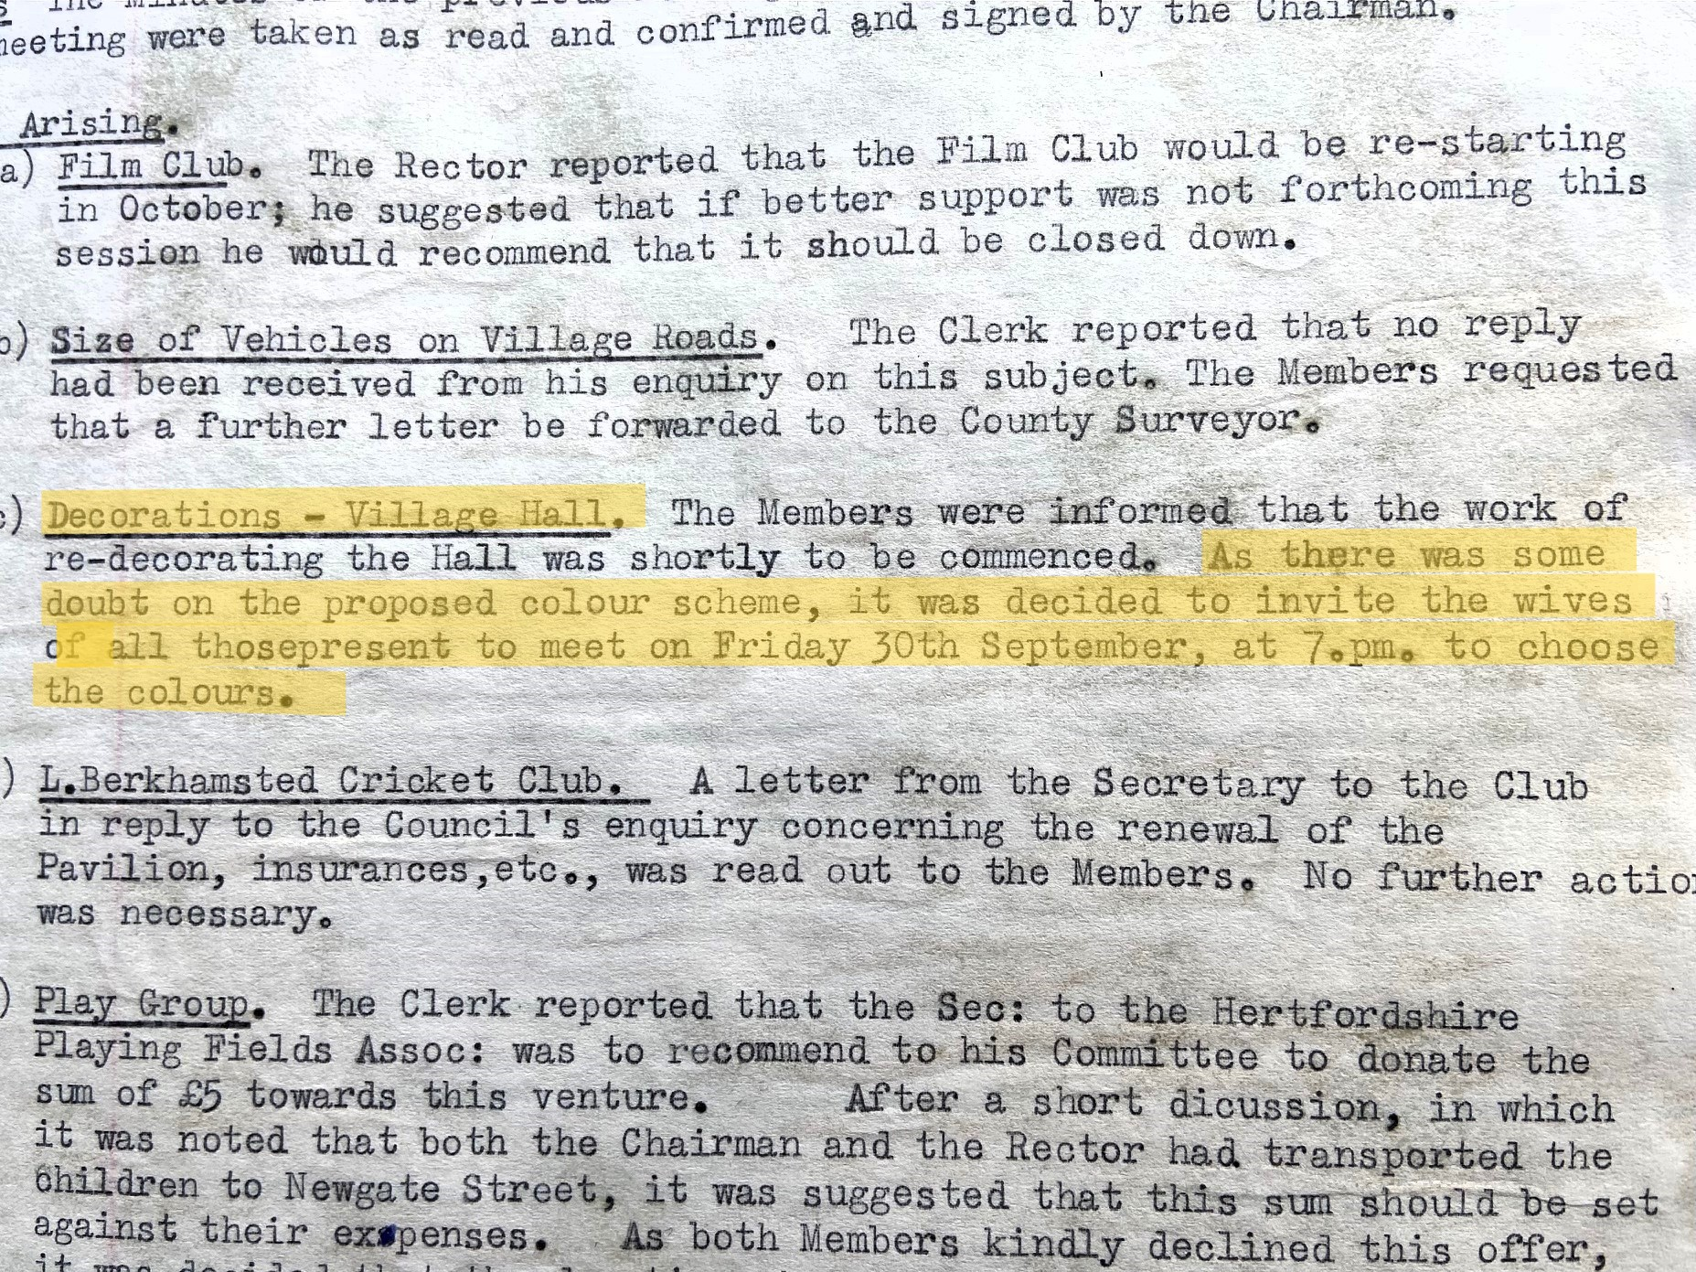
An extract from PC meeting minutes September 1972
External redecoration of the hall
was undertaken in 1975

Slide 16
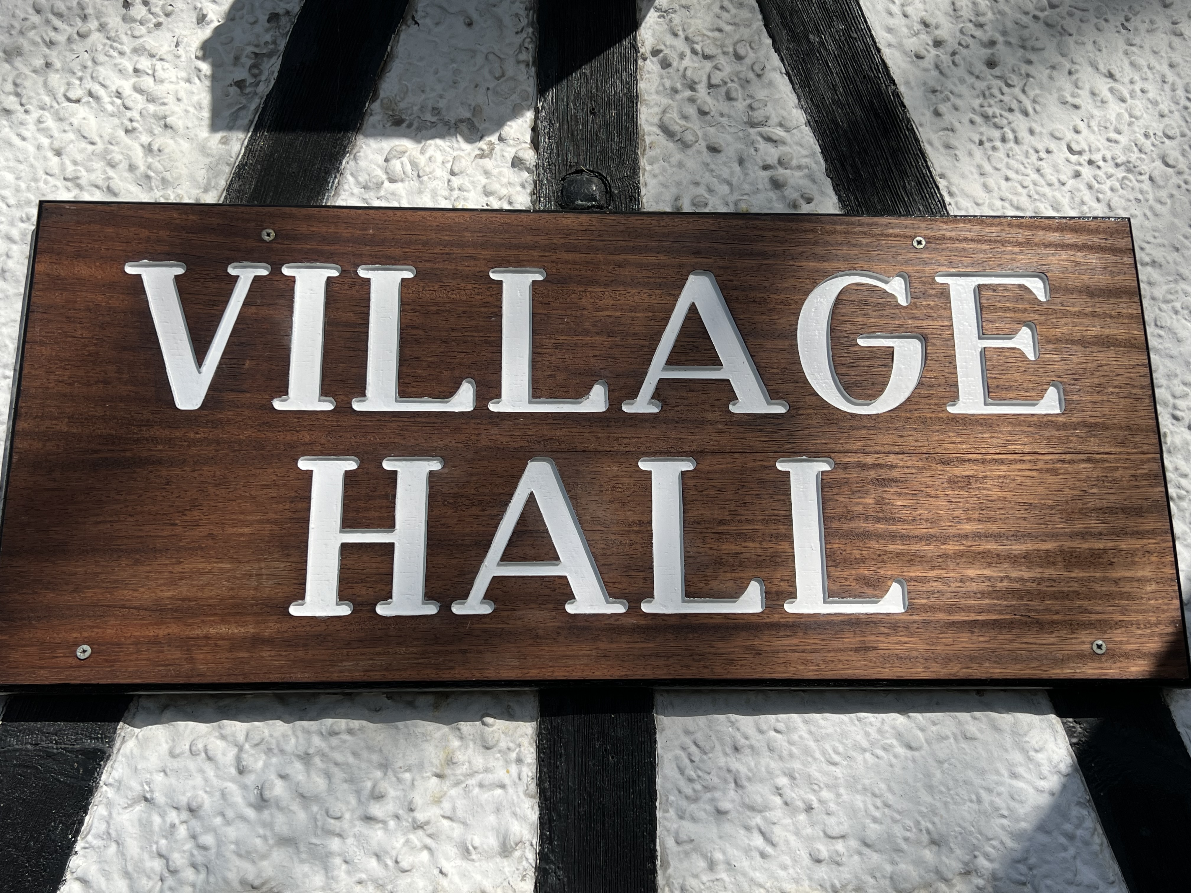
1980s
1982 – internal decorations carried out
1985 – the PC received a grant of £3,500 towards work on the hall floor and roof.
1986 – the roof was stripped back felted and retiled
Village Hall sign put up on exterior wall
1988 – the floor was renewed
At some point around this time the main door to the hall was repositioned on the other side of the porch entrance.

Slide 17
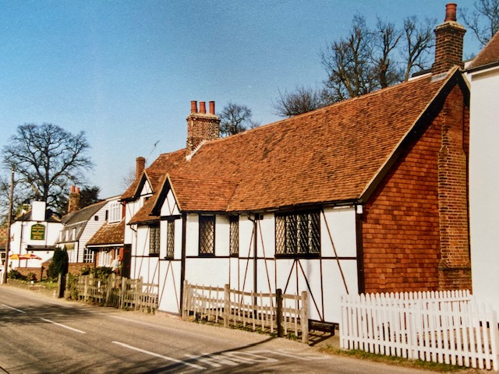
A New Roof in 1986

Slide 18
1990s
1992 – internal redecoration
1996 – the PC received a grant for an internal disabled toilet and improvements to the outside toilets –
so only some progress on the need for
inside toilets first raised in a PC meeting in 1957!

Slide 19
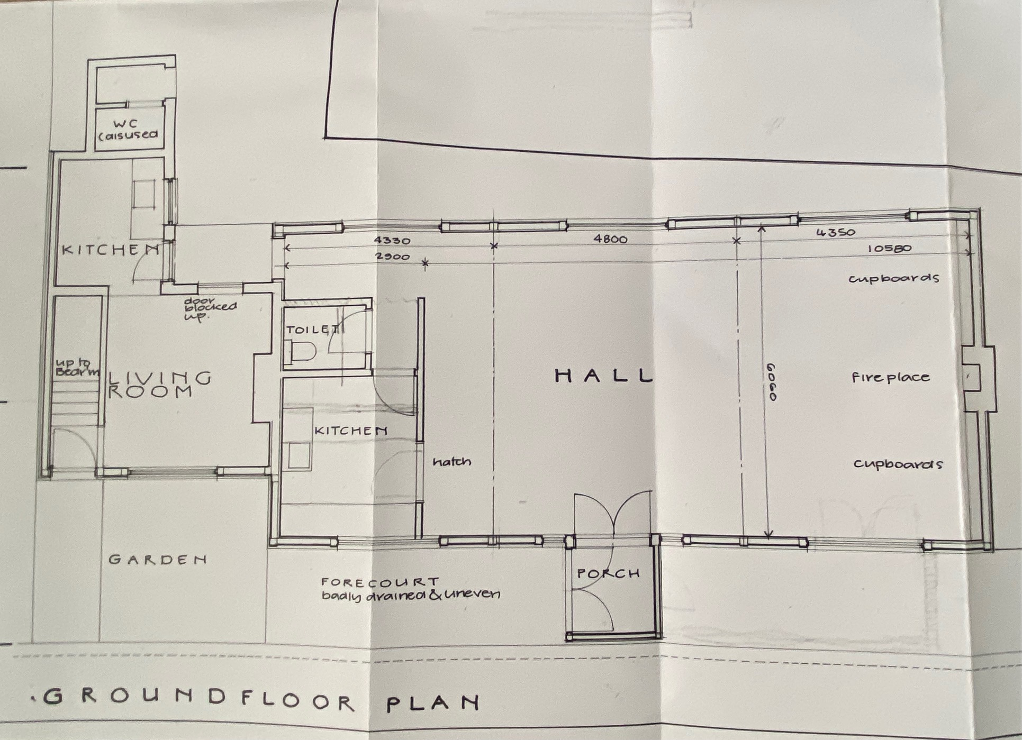
Plan of the Hall c2000

Slide 20
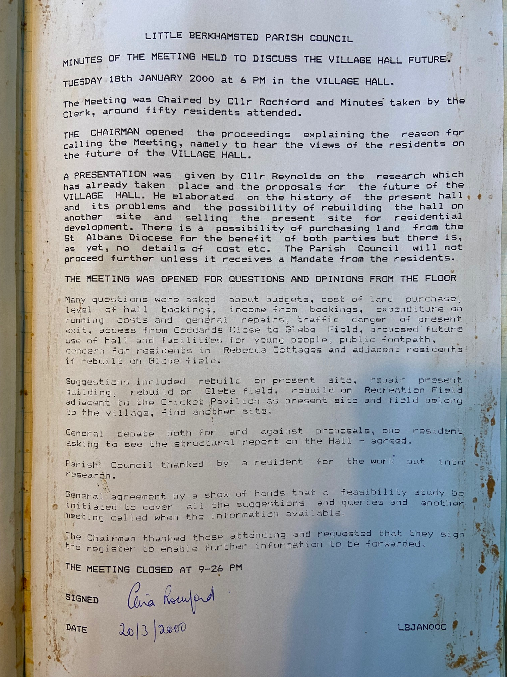
2000s
In January 2000 there was a great deal of discussion with the PCC, St Alban’s Diocesan Board and residents about relocating the village hall either onto the Glebe field, adjacent to the church, on the field or elsewhere in the village.

Slide 21
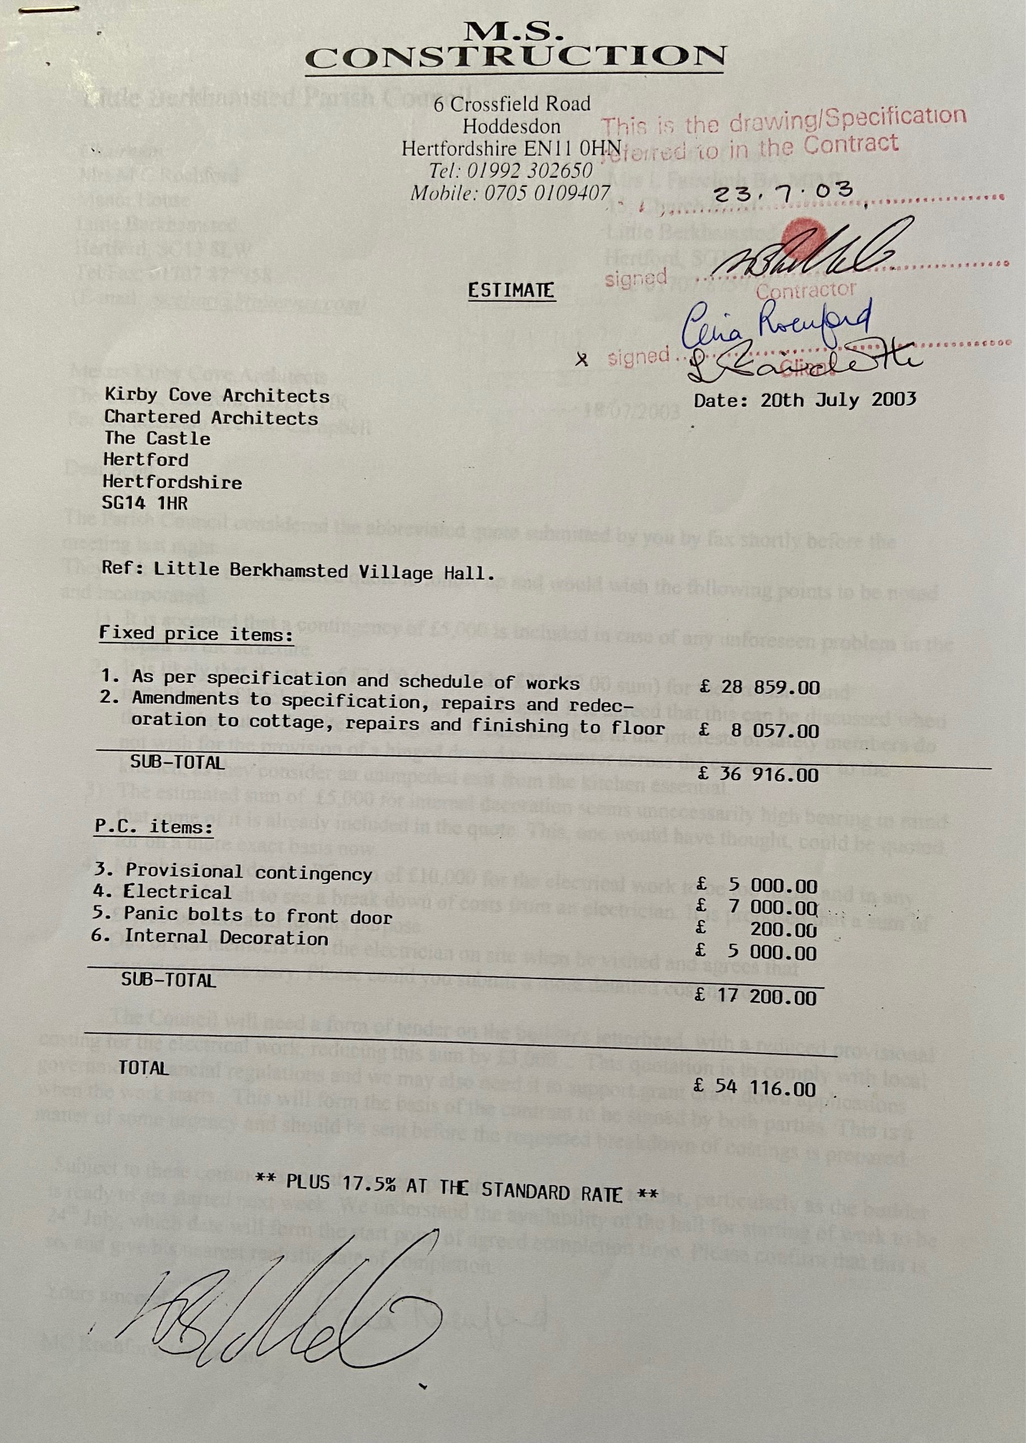
Eventually, it was decided to repair the hall at a cost of £46,059
The work was undertaken by
MS Construction of Hoddesdon.

Slide 22
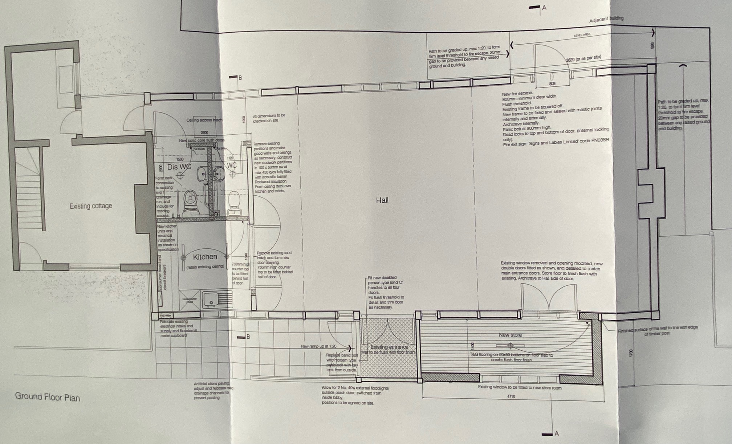
The kitchen is redesigned, 2 indoor toilets are fitted, a fire exit and store cupboard are added.

Slide 23
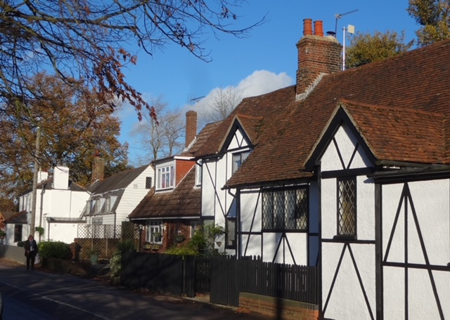

Slide 24
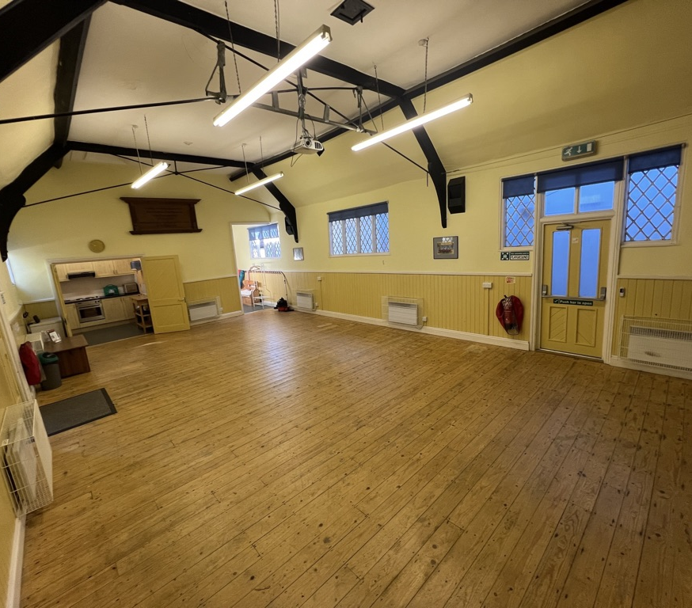
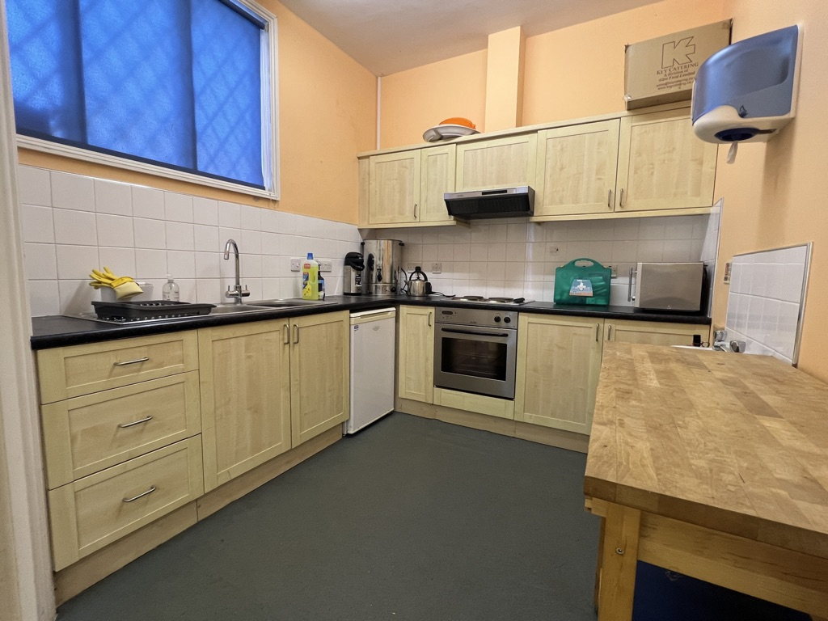
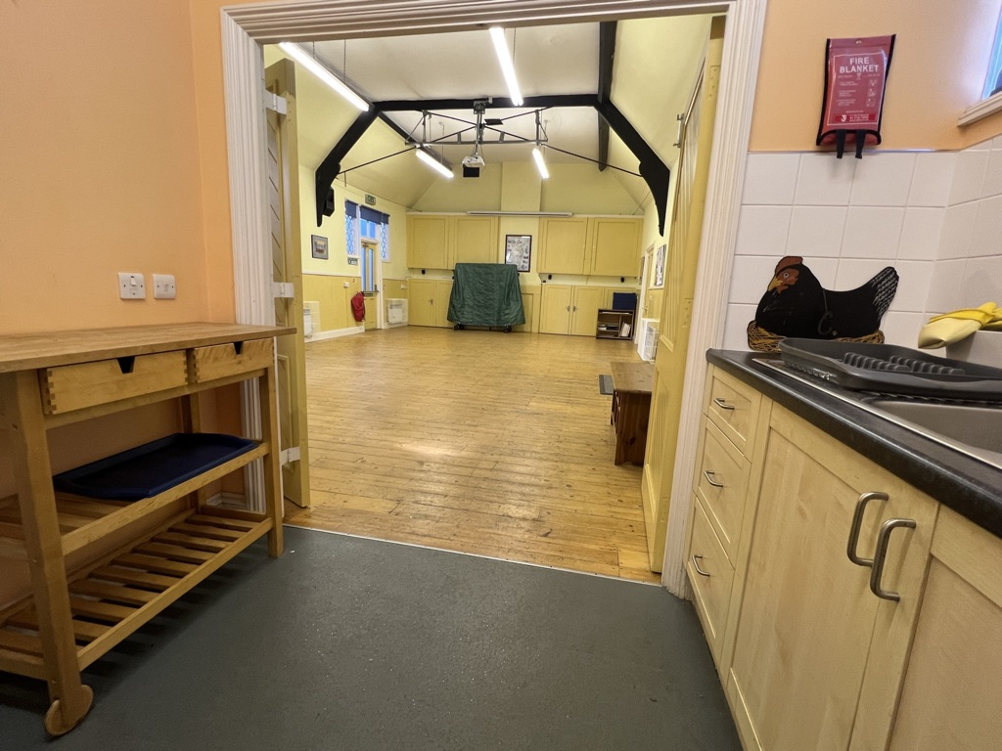
As we remember it………

Slide 25
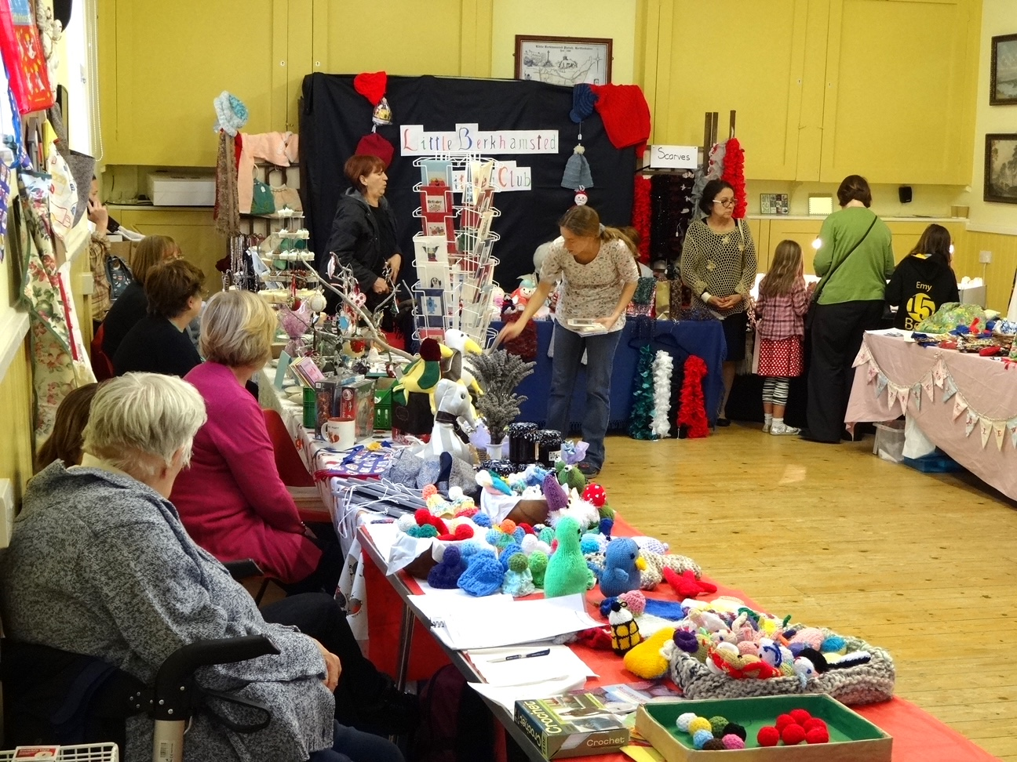
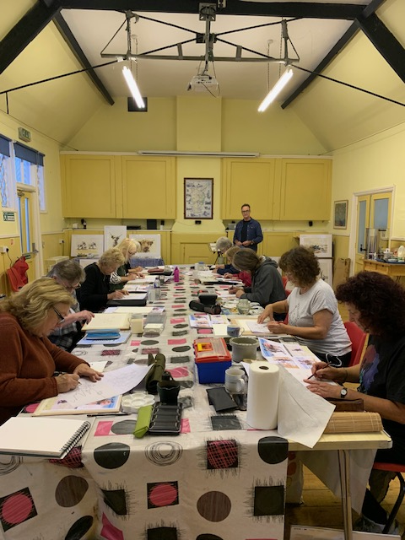
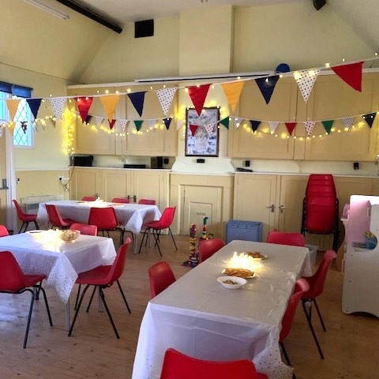
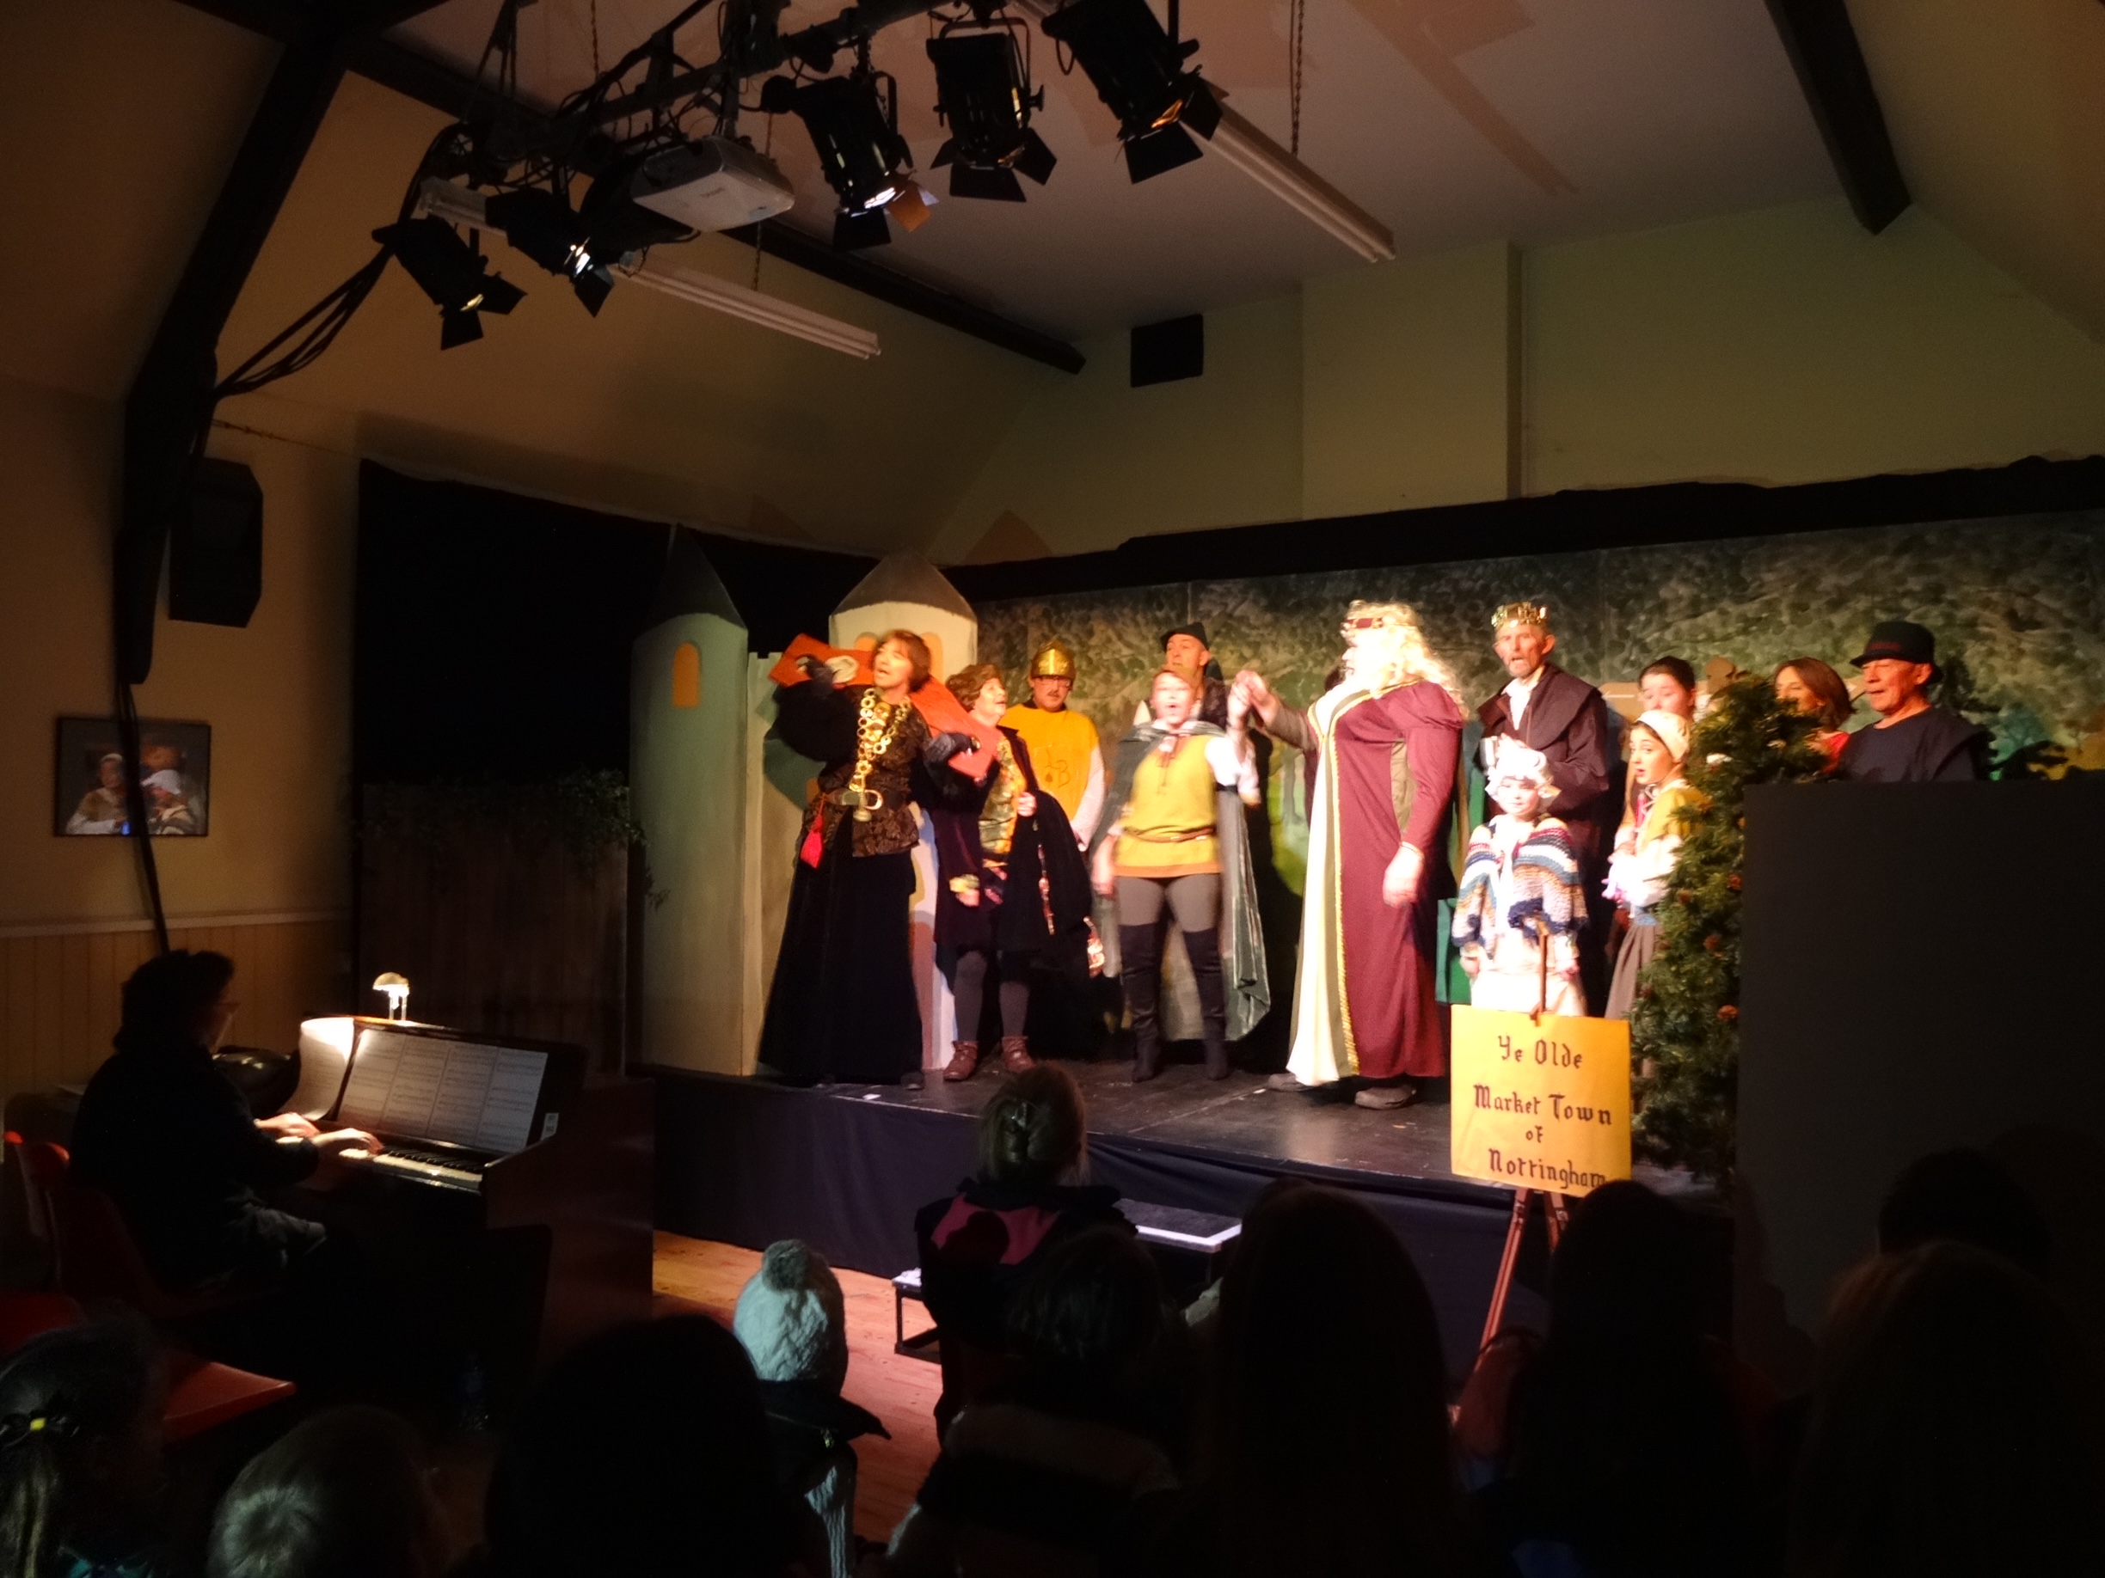
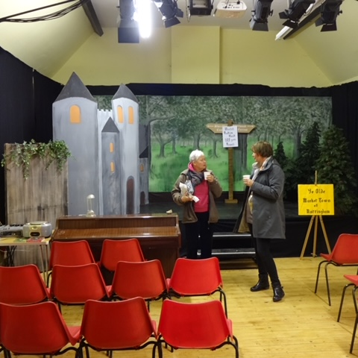
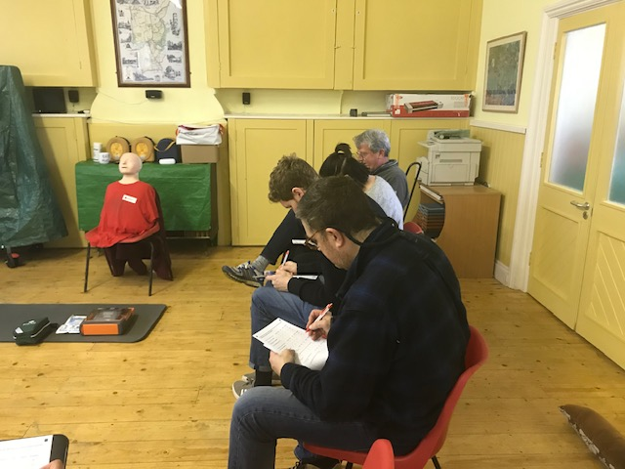
Events in the Hall
Arts and Crafts Fair 2013
MasterArts Workshops
Ready for a Private Party
Christmas Panto 2014
First Aid Training

Slide 26
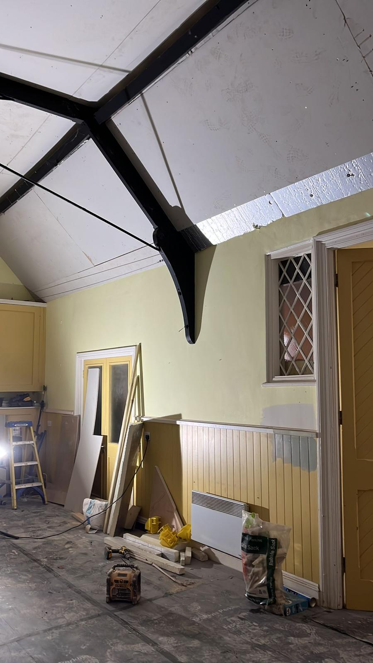
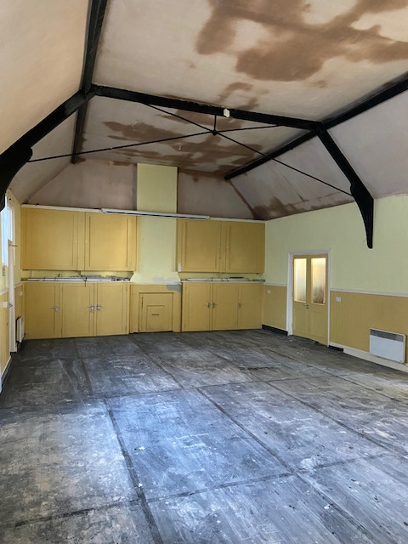
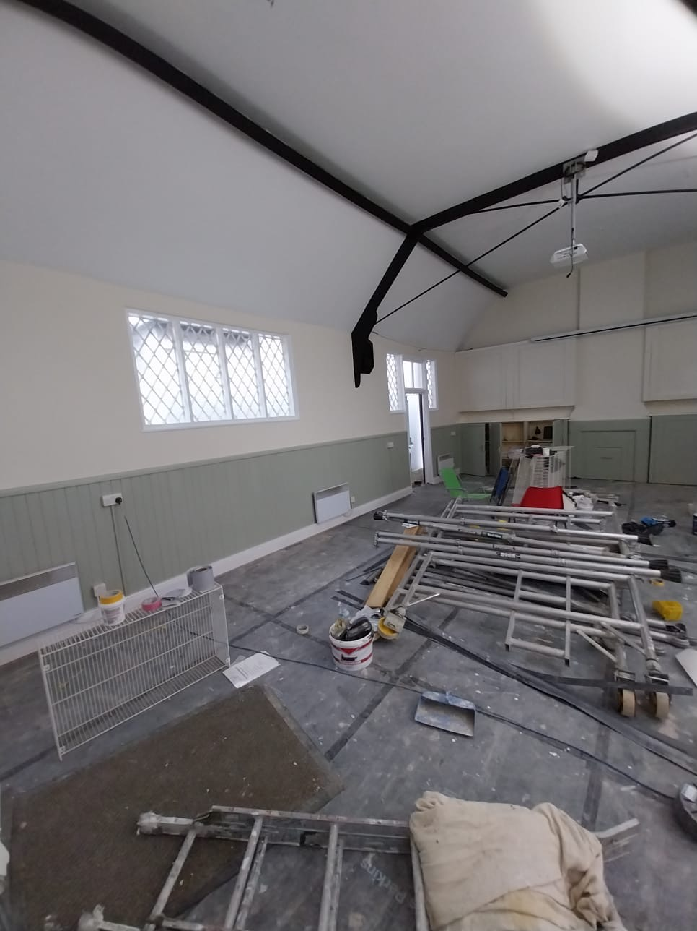
In order to lower heating costs and reduce carbon emissions the hall ceiling has been insulated and replastered, the windows given secondary glazing and LED lights fitted. The hall, kitchen and store cupboard have been redecorated. We received a grant towards these works through the Shared Prosperity Fund managed by East Herts District Council.

Slide 27
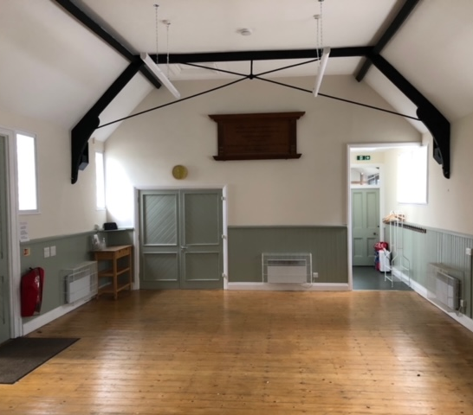
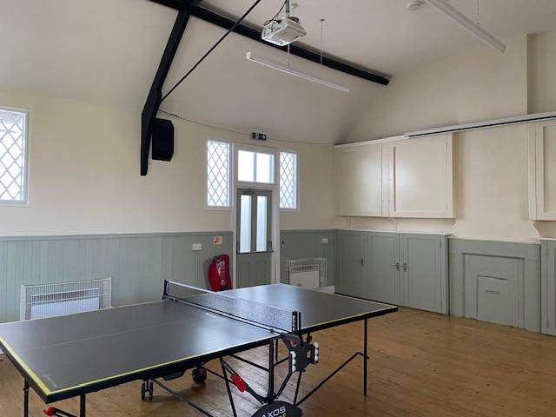
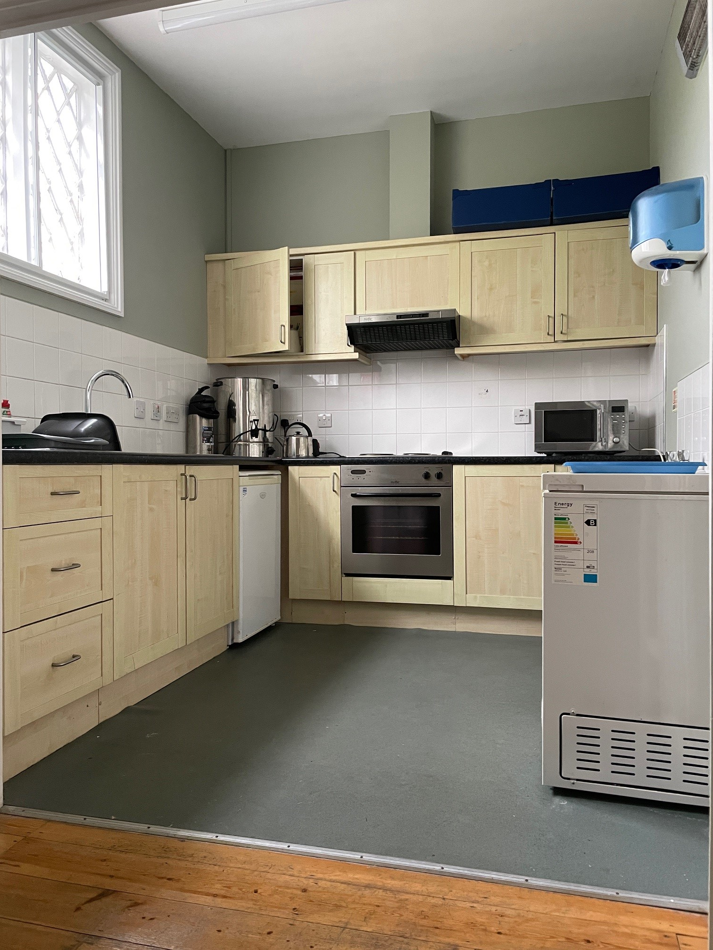
The hall is available for village activities and events, club meetings, classes, exhibitions, training events, private functions and parties. Bookings are welcome from the community and businesses both within and outside the village.

Slide 28
Thank you
The Parish Council would like to thank everyone who has been involved in this latest project on the village hall.
Particular thanks to Cllr Derek Standbrook, who led on the project, giving countless hours of his time and energy.
Thanks also to local resident Simon Hedley who has helped with some of the work.

Slide 29
Thank you for watching!
Many thanks to Rodney Pegg who was a mine of useful, first-hand information.
Penny Stokes is the author of this presentation. Please make contact if you wish to reproduce any part of it.

